Slide 1


Bike Rental Prediction
Pratham Pande

Slide 2
Description
To Predict The Count Of Bike Rental
To Build Random Forest Model
Dependent Var - Count
Independent Var - Season, Year, Month, Holiday, Weekday, Weather Situation, Temperature, Feeling Temperature, Humidity, Wind Speed
Based on the Environment and Seasons

Slide 3
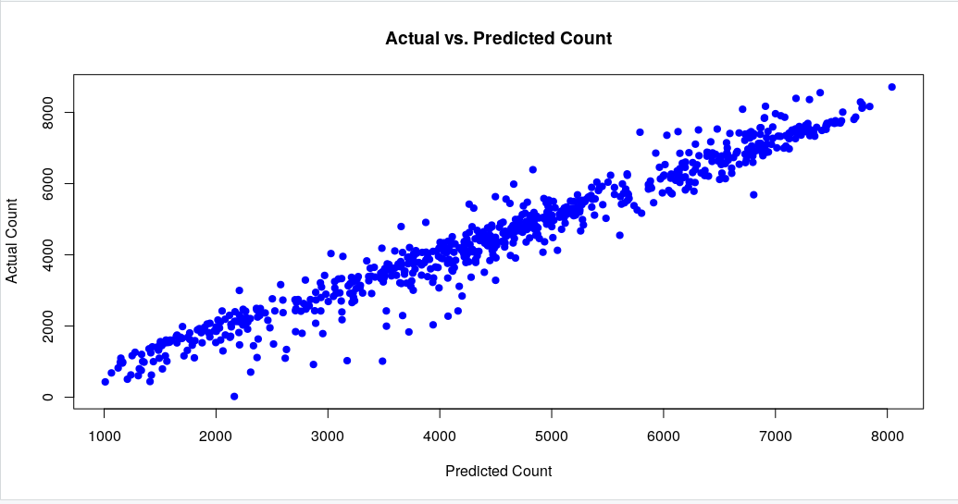
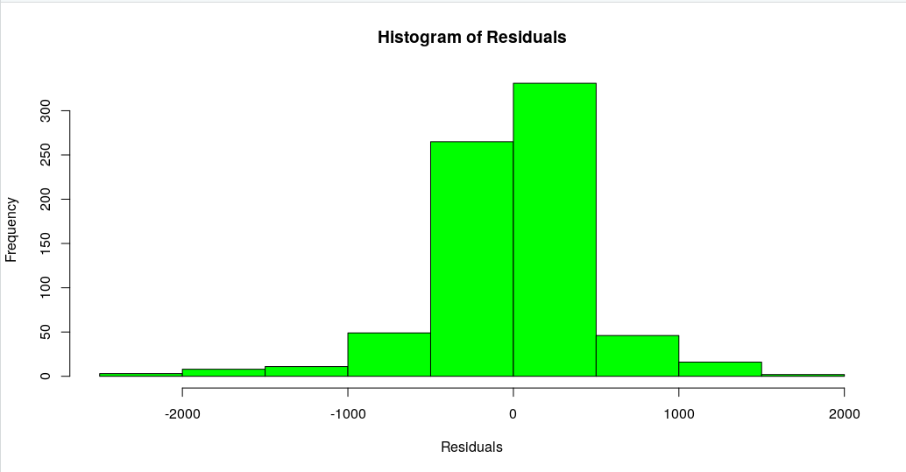
Model Building
Model Evaluation
The model achieved an R-squared value of 0.8860, indicating a strong fit to the data. Although the Mean Squared Error was 453616.4, this was deemed acceptable given the wide range of the ‘count’ variable.
Visualizations confirmed a good correlation between actual and predicted counts, particularly for higher values. The residuals were predominantly centred around zero, suggesting accurate predictions.
The Random Forest algorithm was selected for its robustness and ability to handle non-linear relationships. The model focused solely on environmental and seasonal variables, excluding user type indicators.
Random Forest model was trained using the training set. The model’s performance was assessed through predictions on the test set, followed by the creation of visual plots for further analysis.

Slide 4
Conclusion
The project successfully met its objective to predict daily bike rental counts based on environmental and seasonal factors. The Random Forest model demonstrated strong predictive capabilities, aligning with the project’s goals

Slide 5
The End
Thank you

